Slide 1

Mini Project II
FloraShop
(E-commerce Website)
Presented by:
Aman Kumar(201500074)
Nandini Singh(201500431)
Shivani Singh(201500661)
Kavya Agarwal(201500335)

Slide 2

Know our website…
Can't make it to your loved one's special events in other cities? Browse our exquisite collection of flowers, select your favorites, and let us take care of the rest.From weddings to birthdays, our expert florists will create the perfect arrangement to make your special moment even more memorable.Come and explore our world of flowers - we can't wait to brighten up your day!

Slide 3
ROADMAP
Registeration Screen
User Home Screen
New Product Screen
1
3
5
2
4
6
Sign-In Screen
Cart Screen
Contact Screen

Slide 4
Purpose and Motivation
The old manual system was suffering from a series of drawbacks. Since the whole of the system was to be maintained with hands, the process of keeping, maintaining and viewing was very tedious and lengthy. This could result in the flowers becoming soggy or dried. The main motivation behind the development of this website are as follows:
Improved customer experience: This website can provide customers with a better experience by offering features like easy navigation, product reviews, and personalized recommendations. This can help increase customer satisfaction and loyalty.
Meeting customer demand: People often like to buy flowers for various occasions like birthdays, weddings, anniversaries, or just to decorate their homes. This website for selling flowers can help meet this demand by providing a convenient and accessible platform for customers to purchase flowers.

Slide 5
SCREENS NAVIGATION TO DIFFFERENT
FUNCTIONALITIES OF THE WEBSITE

Slide 6
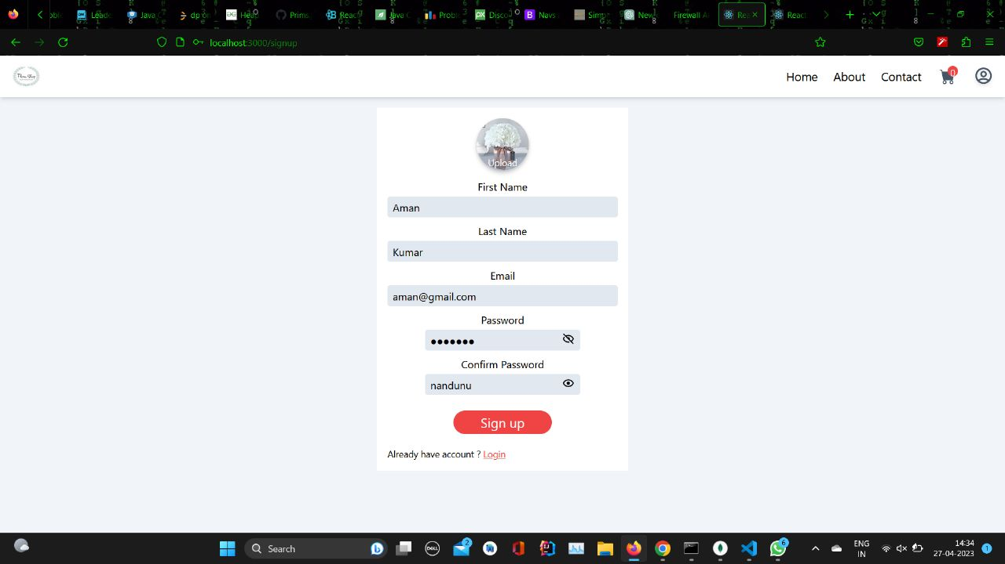
Registration Page
The registration page requires the user to enter Name, Email and Password of the account.
The page displays an error if the gmail is inavlid.
The page displays an error if the passwords mismatch.

Slide 7
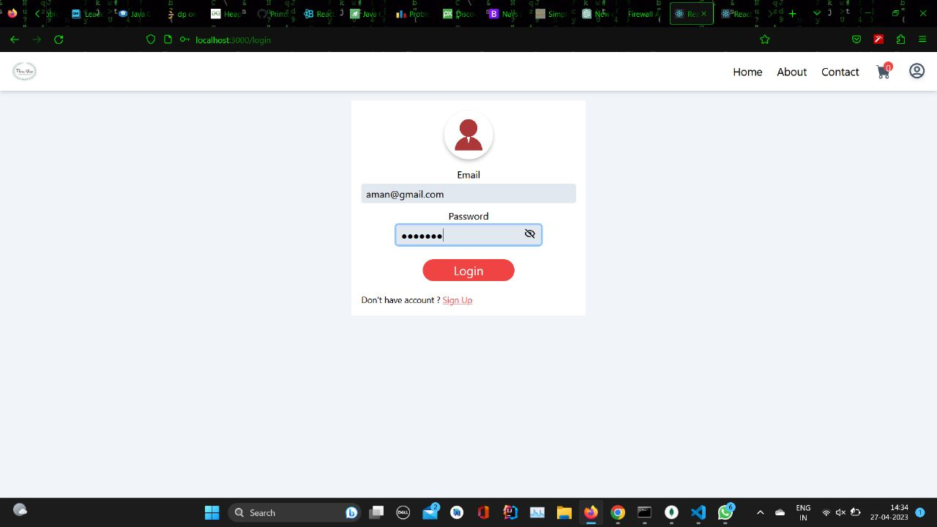
Sign In Page
The user can Sign-in to the app using email and password.
Only a registered user can sign in using the correct credentials.
The user can also upload his/her photo to the profile.
If wrong email or password is entered,an error message is
displayed.

Slide 8
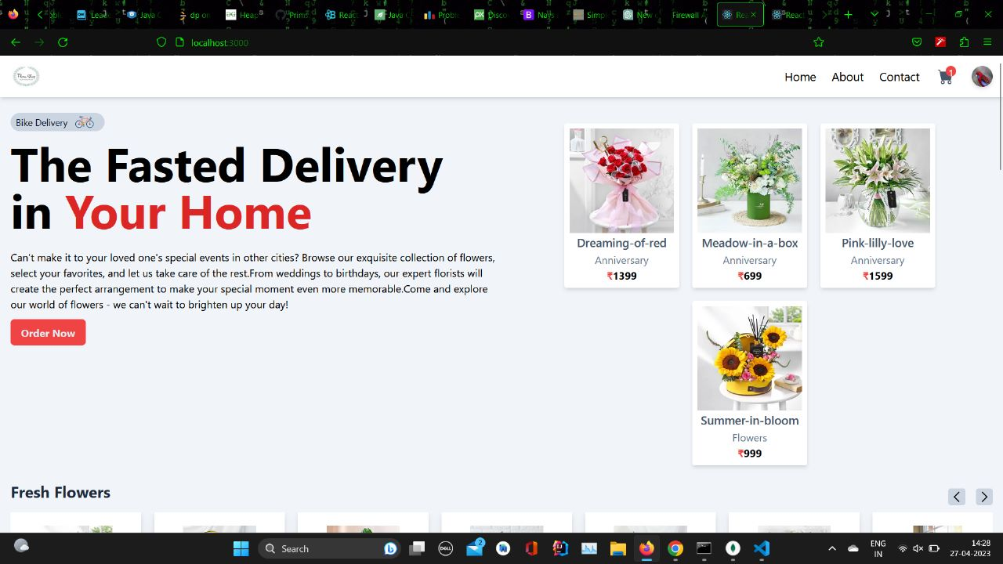
Home Page
A clean , organized user-friendly UI.
Separate pages for home,about,contact,profile and catalogue.

Slide 9
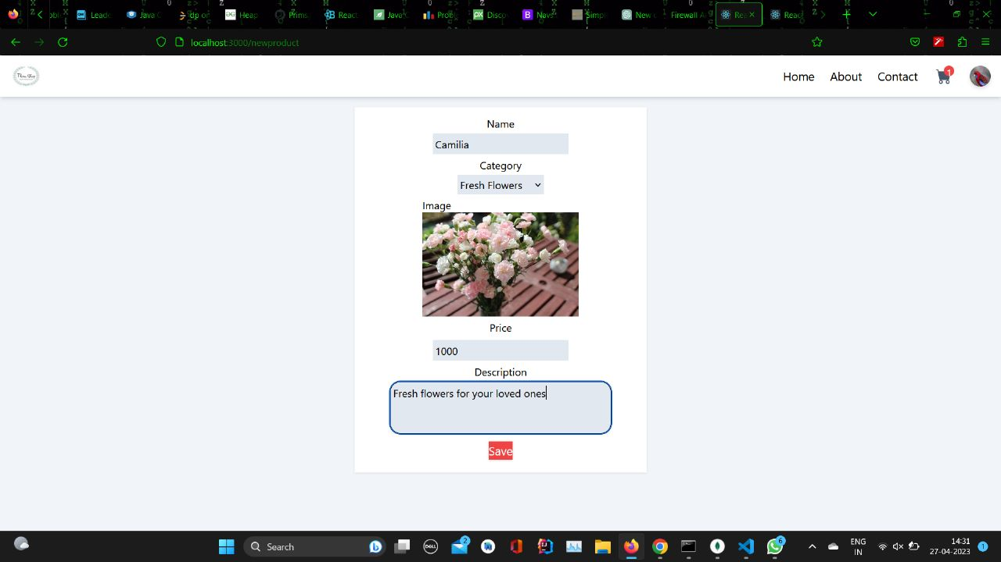
Add new product Page
On clicking ‘Add new product’ option, a form to apply for new flower opens.
The admin can add new products to the website from here by providing the details such as name,price,description etc.

Slide 10
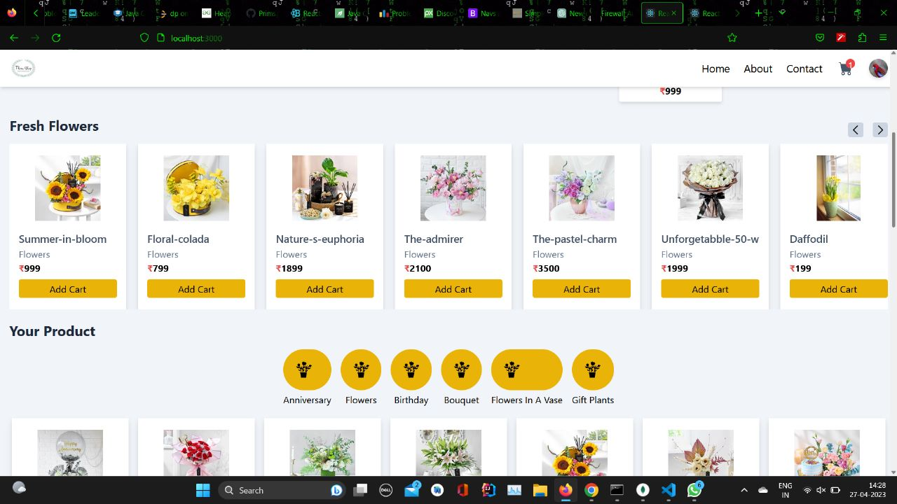
Catalogue Page
Users can see the entire menu from the website by scrolling
The user can click on add to cart option to add the product to cart.
The user can also categorise the search according to the occasion.

Slide 11
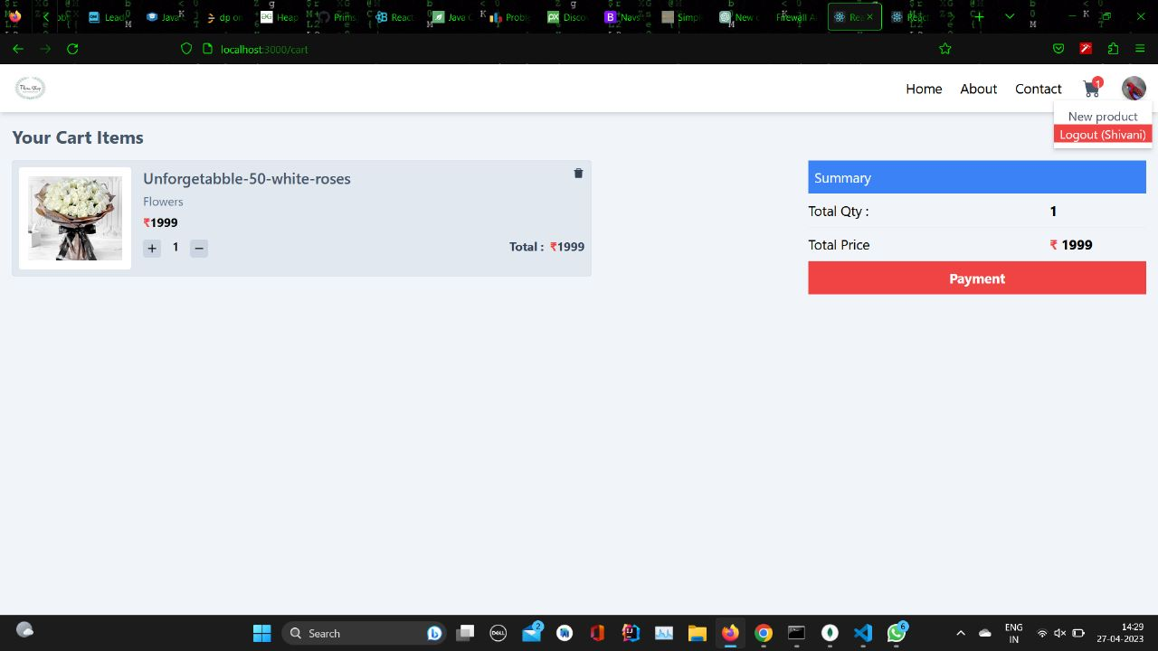
Add to Cart Page
The user can click on add to cart option to add the product to cart.
The user can also delete products from the cart and the billing amount reflects the same

Slide 12
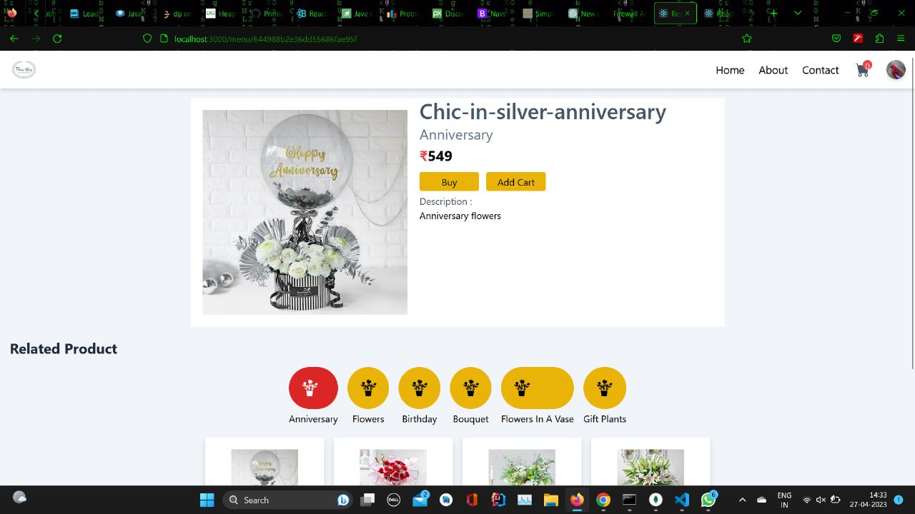
Item Description Page
The user can click on the product to display it in detail.
The item description page enlists the name,description,price and the best suited occasions for the flower product.

Slide 13
Features
Offering a wide selection of flowers
Providing detailed product information
Providing exceptional customer service
Offering competitive pricing and promotions
Ensuring security and privacy

Slide 14
MERN
Technologies Used:
(MONGODB,EXPRESS,REACTJS,NODEJS)

Slide 15
MongoDB
MongoDB is a popular open-source document-oriented database management system that provides high performance, scalability, and flexibility.
It is designed to store and manage unstructured data, such as JSON documents, making it well-suited for modern web applications that handle large volumes of data.
One of the key features of MongoDB is its ability to scale horizontally, allowing it to handle large amounts of data and traffic with ease.

Slide 16
EXPRESS JS
Express.js is a popular open-source web application framework for Node.js that simplifies the process of building web applications and APIs.
It provides a lightweight and flexible architecture that allows developers to quickly and easily create scalable and modular web applications.
It is known for its minimalist design, which makes it easy to use and customize. It provides a wide range of features and middleware that can be used to handle requests, routes, views, and more.
Additionally, it has a large and active community of developers who contribute to its ongoing development and maintenance.One of the key advantages of Express.js is its versatility.

Slide 17
Node JS
\
Node.js is built on top of the V8 JavaScript engine, which is the same engine that powers the Google Chrome web browser.
It provides a non-blocking I/O model and event-driven architecture, which allows it to handle large amounts of data and traffic with ease.
One of the key advantages of Node.js is its ability to handle real-time, data-intensive applications. It provides a wide range of modules and libraries that can be used to handle tasks such as networking, file I/O, and database access.
Additionally, it has a large and active community of developers who contribute to its ongoing development and maintenance.
Node.js is also known for its speed and scalability. It can handle large volumes of concurrent connections and requests, making it ideal for building scalable and high-performance web applications.

Slide 18
React JS
React is an open-source JavaScript library that is used for building user interfaces. It was developed by Facebook and has gained immense popularity due to its ease of use and scalability.
React enables developers to create reusable UI components and makes it easier to manage the state of an application.
One of the key features of React is its ability to create declarative views that make the code more predictable and easier to debug. This is achieved through the use of a virtual DOM (Document Object Model), which is a lightweight representation of the actual DOM.
When changes are made to the virtual DOM, React efficiently updates only the necessary parts of the actual DOM, reducing the need for expensive DOM operations and improving performance.
React also supports the use of JSX (JavaScript XML), which is a syntax extension that allows developers to write HTML-like code in JavaScript.
React can be used with other technologies such as Redux for state management, React Router for routing, and Node.js for server-side rendering. It is also widely used in conjunction with other front-end frameworks such as Angular and Vue.

Slide 19
THANK YOU

